Slide 1
glucose

Slide 2
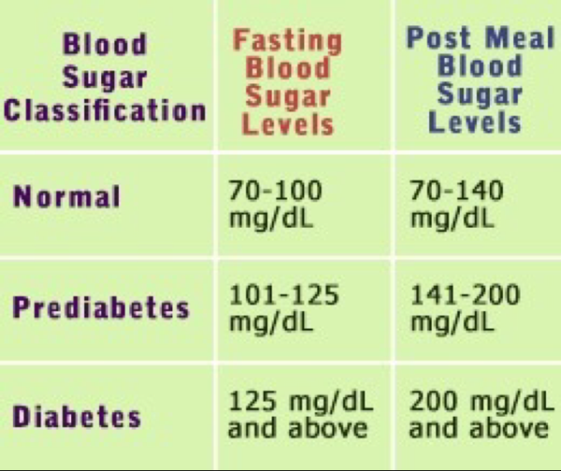
Glucose is the main type of sugar in the blood and is the major source of energy for the body's cells. Glucose comes from the foods we eat or the body can make it from other substances. Glucose is carried to the cells through the bloodstream. Several hormones, including insulin, control glucose levels in the blood.

Slide 3
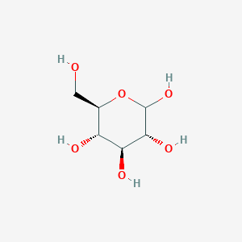

Slide 4
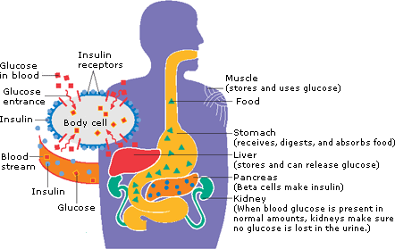

Slide 5
